Slide 1

Forest Fire Model
Team 4:
Alice Chen
Zhou Chen
Bingjing Dong
Shanshan Li

Slide 2

What is Forest Fire
Any uncontrolled and non-prescribed combustion or burning of plants in a natural setting such as a forest, grassland, brush land or tundra, which consumes the natural fuels and spreads based on environmental conditions.

Slide 3
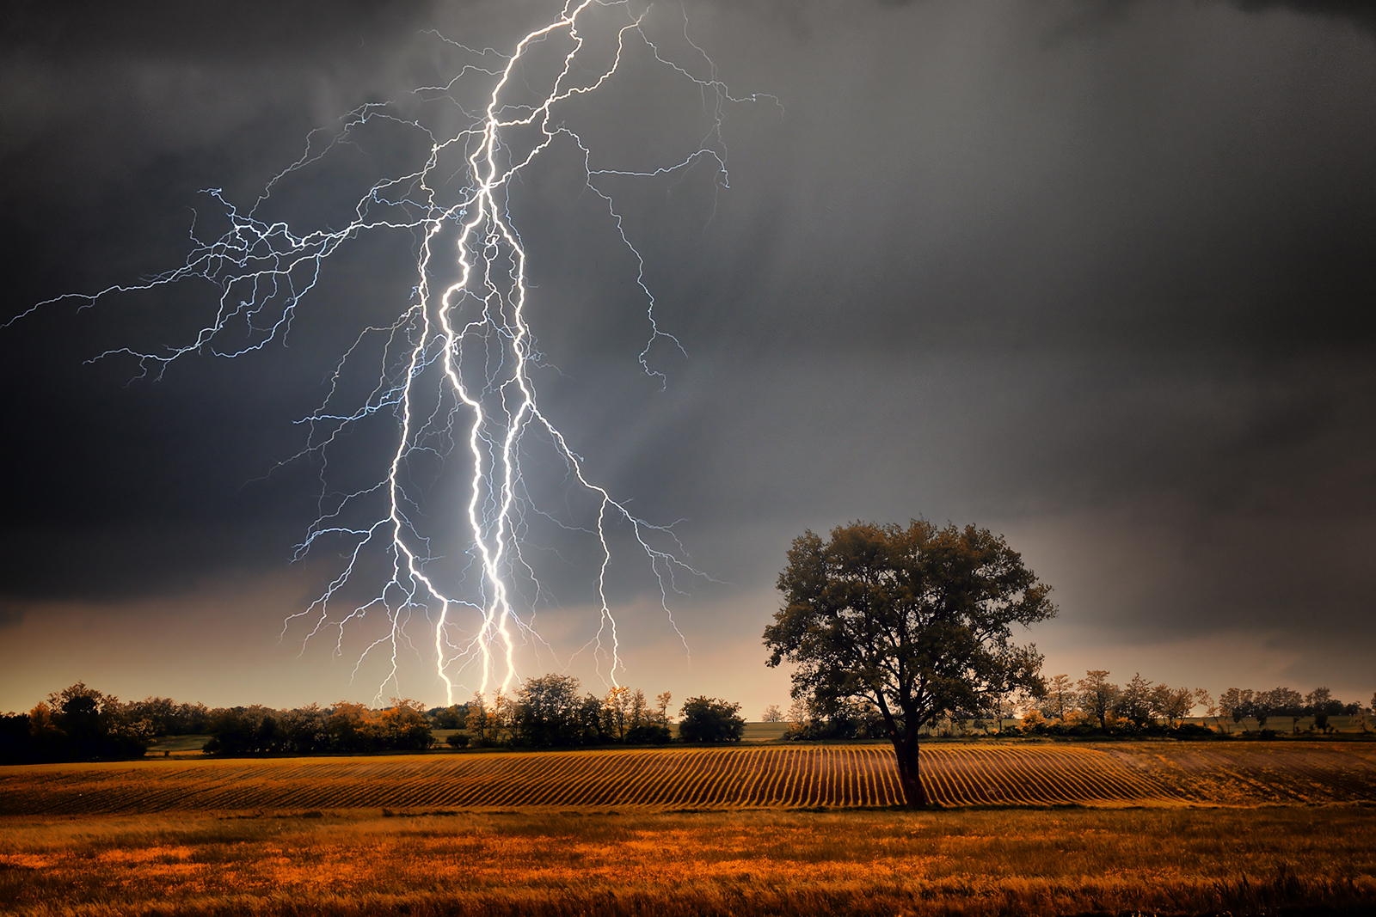
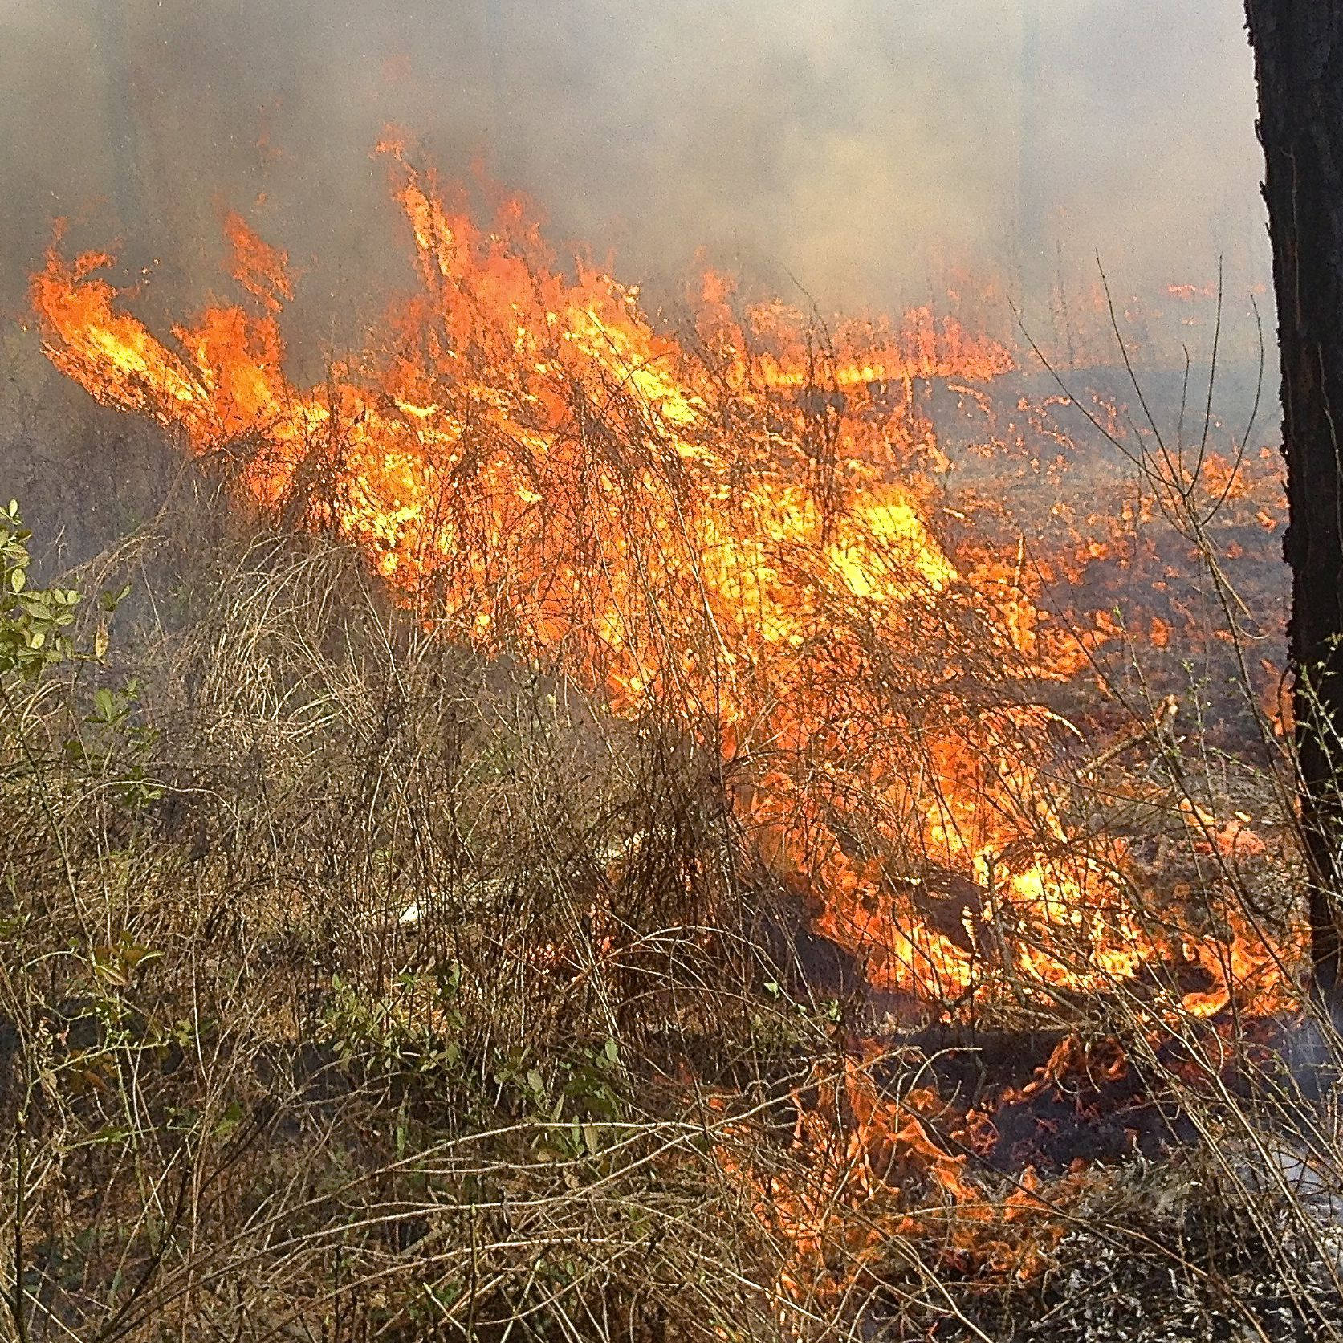
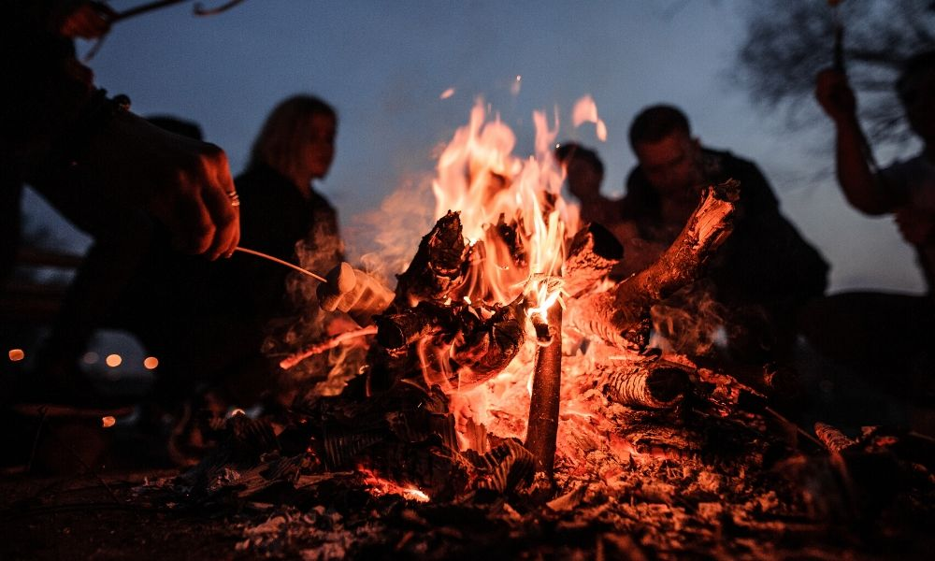
Cause of Forest Fires
Natural
Lighting associated with thunderstorm
Human
Negligence
Criminal act
Accidents
Notes:
Forest fires always start by one of two ways - naturally caused or human caused. Natural fires are generally started by lightning, with a very small percentage started by spontaneous combustion of dry fuel such as sawdust and leaves.
On the other hand, human-caused fires can be due to any number of reasons.

Slide 4
Why simulates Forest Fire
Strong contingency and suddenness, and easily to propagates fire to wide area.
Causes huge losses to forest resources and impacts ecological balance and ecosystem stability.
Designing the fast risk management and implementing effective suppression policies.
To predict forest fires to avoid damage both to the forest area and residential areas around the forest.

Slide 5
Types of Forest Fire
Ground Fires
Occur when plant roots and other organic matter below the soil surface ignite.
Surface Fires
Which burn dead or dry vegetation that’s lying or growing just above the ground.
Crown Fires
Burn through the tree canopy, fires can spread quickly due to the influence of wind is greater in the canopy.
Notes:
There are essentially three main types of Forest Fire that can occur: ground fires, surface fires, and crown fires.
Crown fires burn trees up their entire length to the top. These are the most intense and dangerous wildland fires.
Surface fires burn only surface litter and duff. These are the easiest fires to put out and cause the least damage to the forest.
Ground fires (sometimes called underground or subsurface fires) occur in deep accumulations of humus, peat and similar dead vegetation that become dry enough to burn.
These fires move very slowly, but can become difficult to fully put out, or suppress.

Slide 6

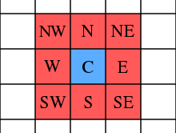
Design of Model
N x M Cellular Automata.
Randomly distribute tree cell among grid.
Input Parameters
Density
Fire Weather Index
month, temperature, relative humidity, wind speed, rain fall
Forest fire propagating based on Moore Neighborhood by default.
Fire propagation changes direction time to time.

Slide 7
Fire Weather Index
A meteorologically based index used worldwide to estimate fire danger. It consists of different components that account for the effects of fuel moisture and wind on fire behavior and spread. It is a calculated using the air temperature, relative humidity, and wind speed for a given day
Notes:
Rare
Unusual
Often and common
Perfect environmental conditions

Slide 8

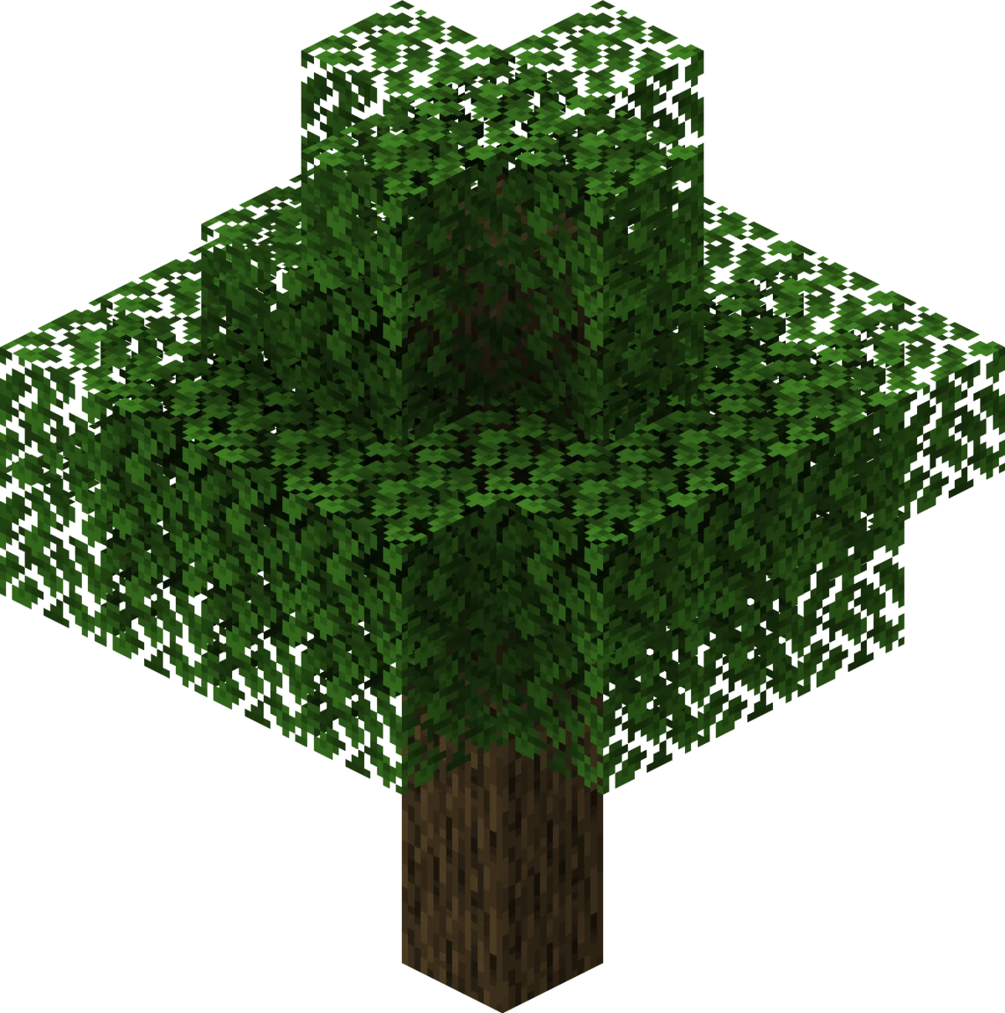
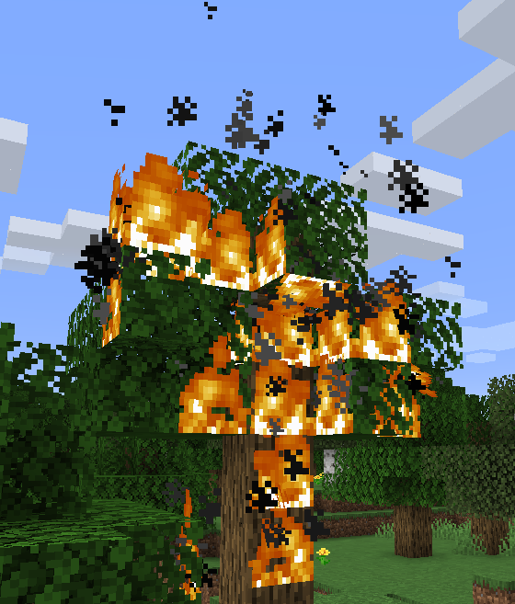
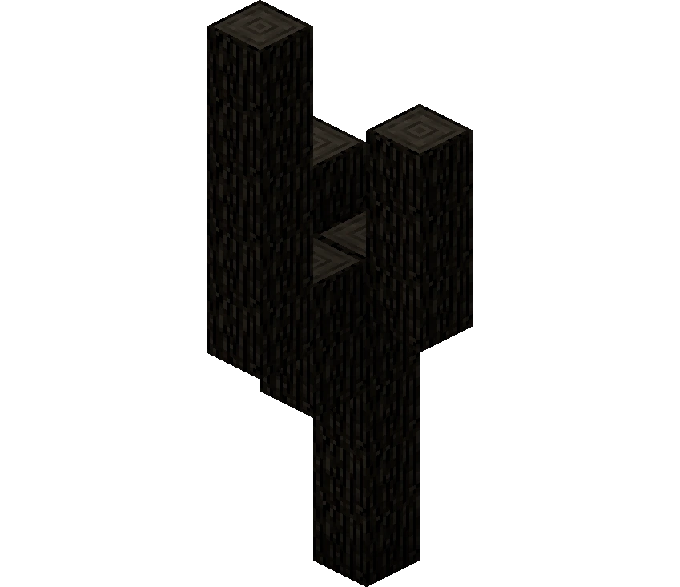
States of Model
Ground - Brown
Tree - Green
Burning Tree - Orange
Burnt Tree/Char - Black
Notes:
In this forest fire model, we have defined 4 states

Slide 9
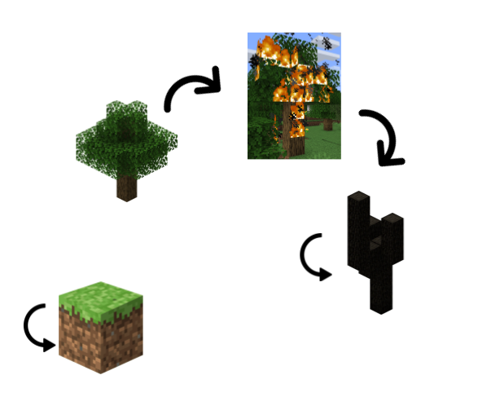
Transition Rules
Ground and Burnt Tree cells will stay in same state.
A tree cell becomes a burning tree cell if:
Tree cell is a neighbor of a burning tree cell and
Probability f >= probability derived from fire weather index

Slide 10
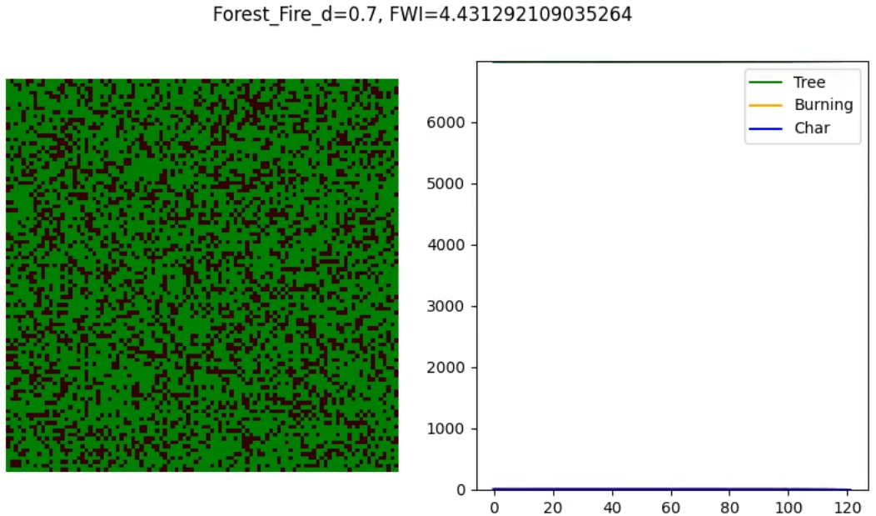
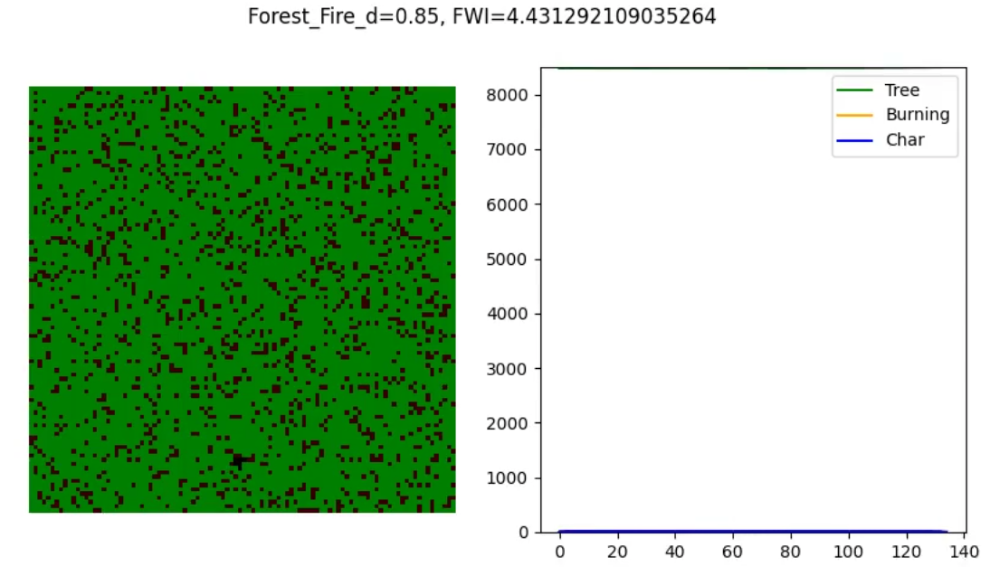
Forest Fire Simulation No Direction Change

Slide 11
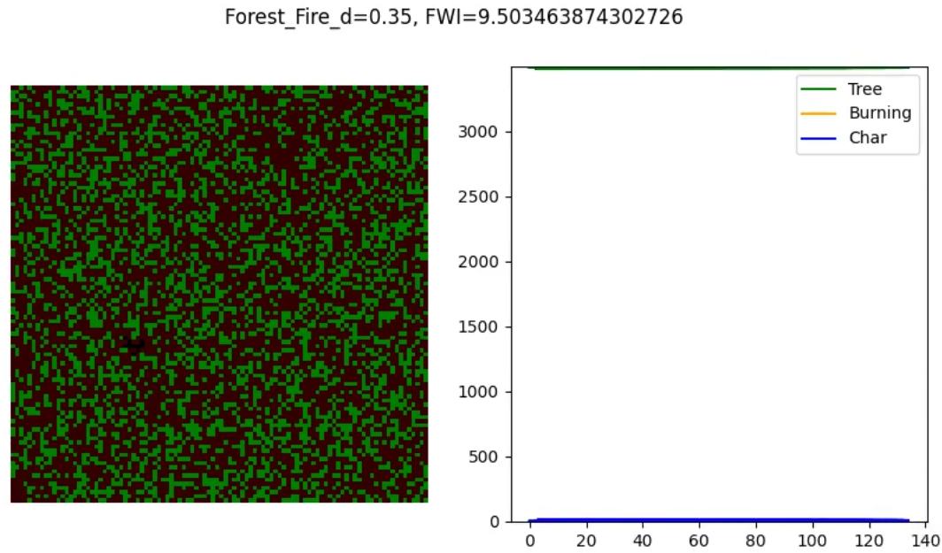
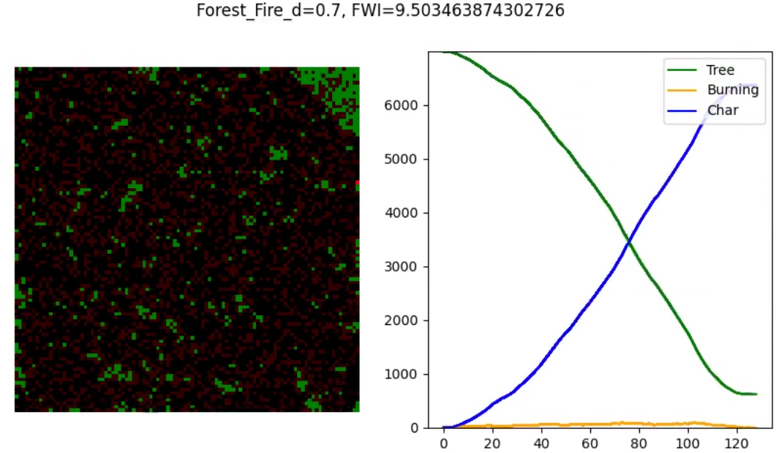
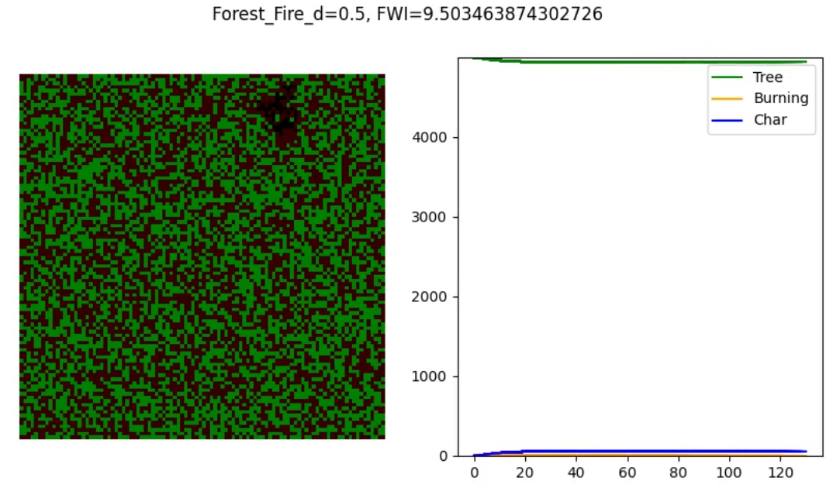
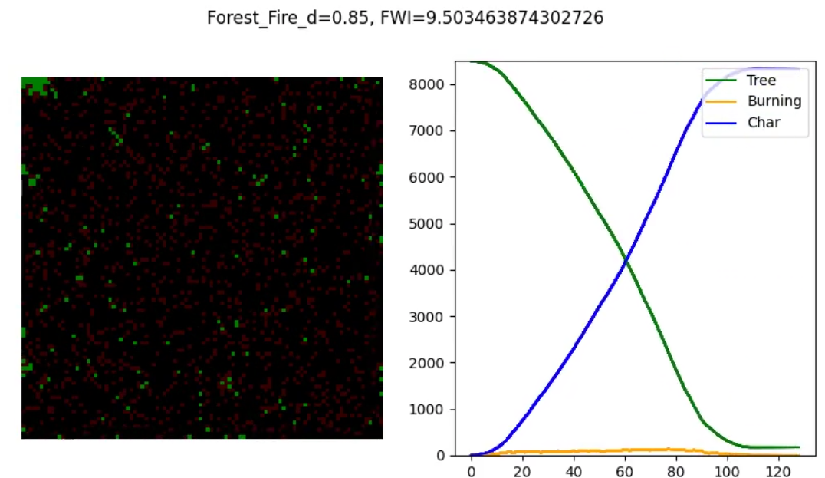

Slide 12
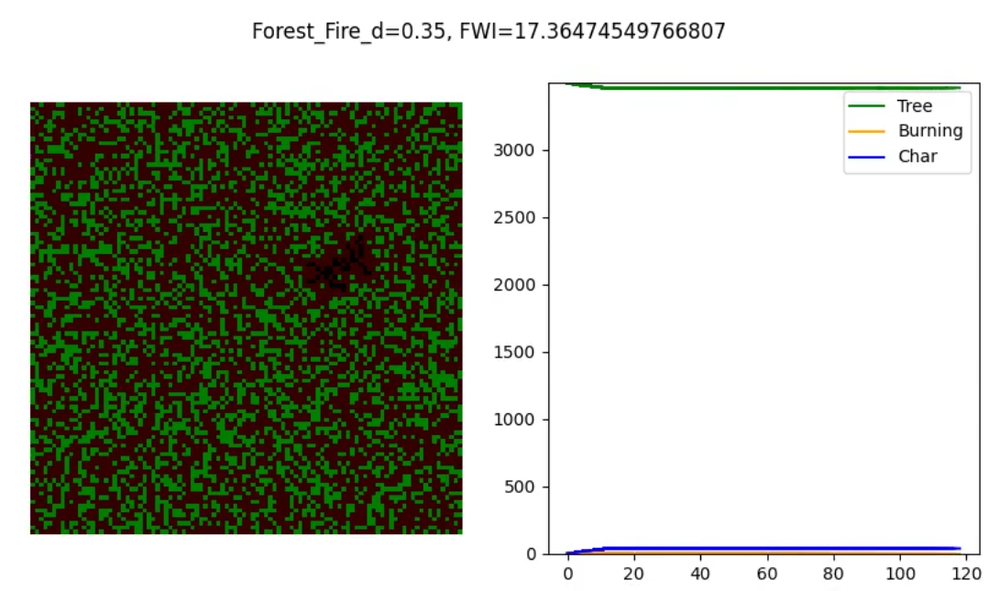
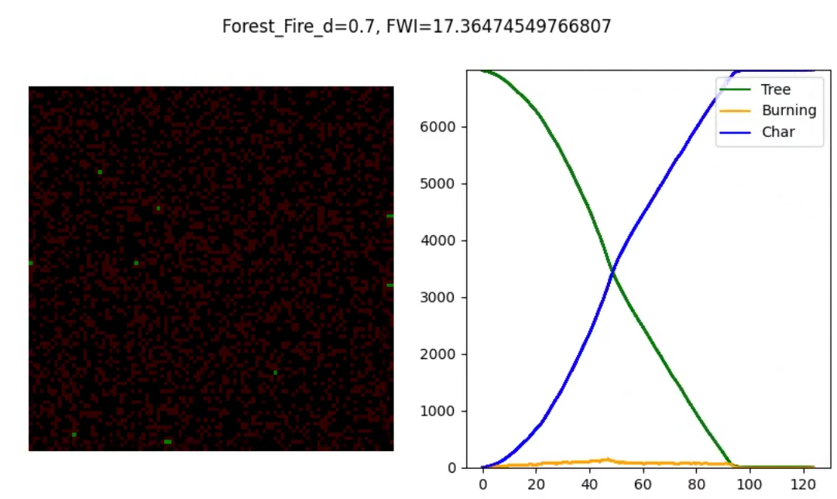
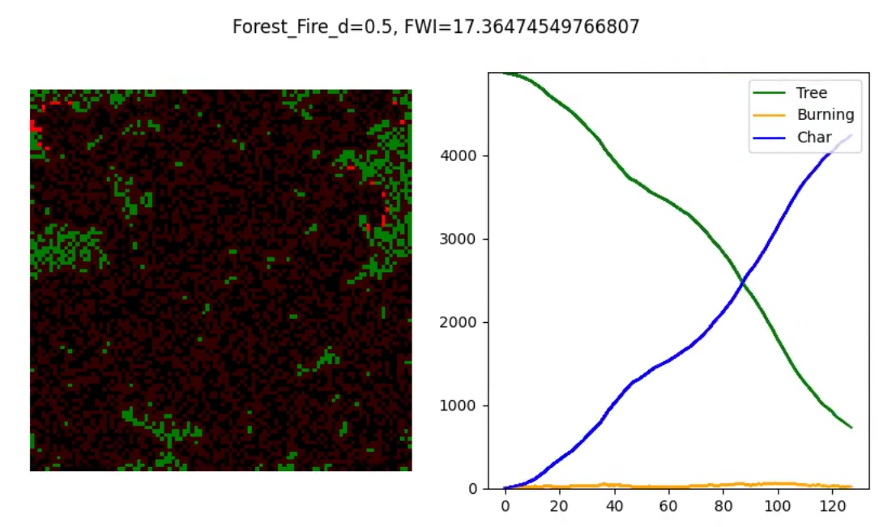
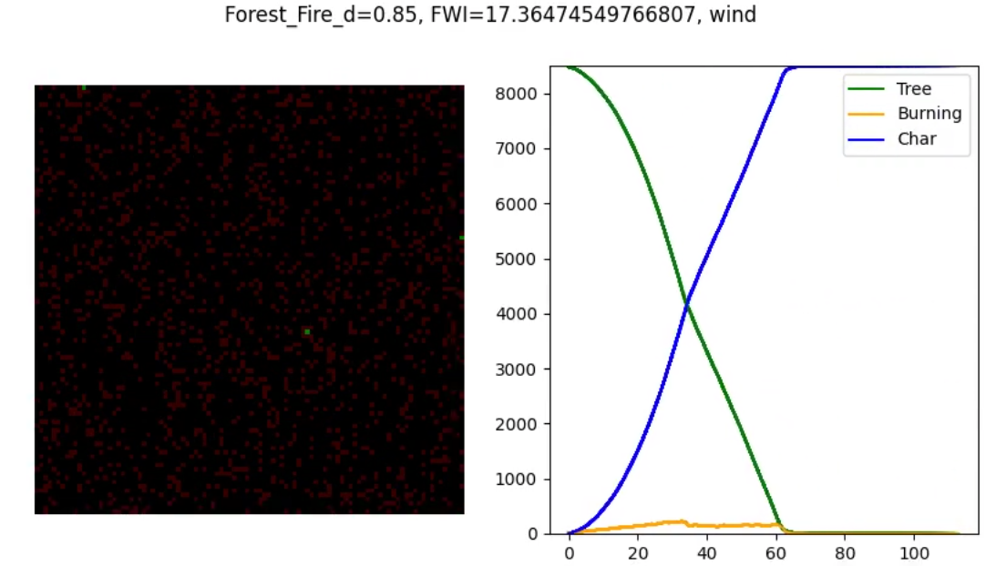

Slide 13
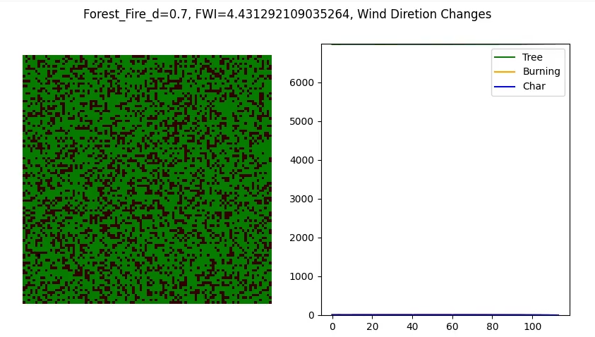
Forest Fire Simulation with Direction Change

Slide 14
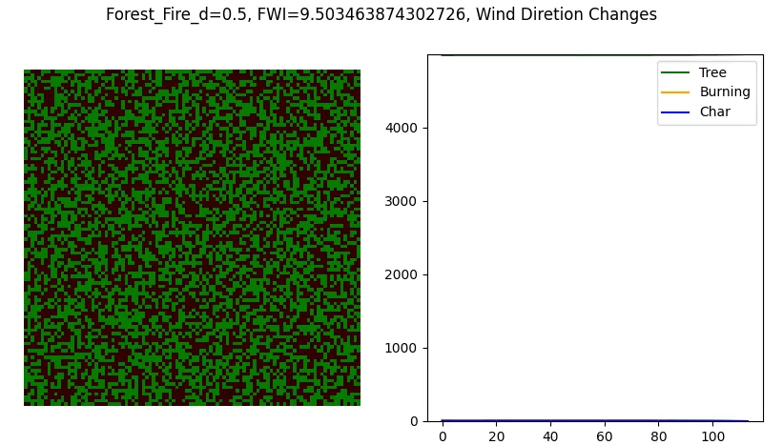
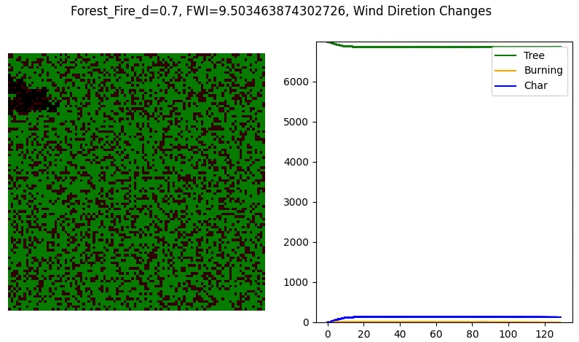
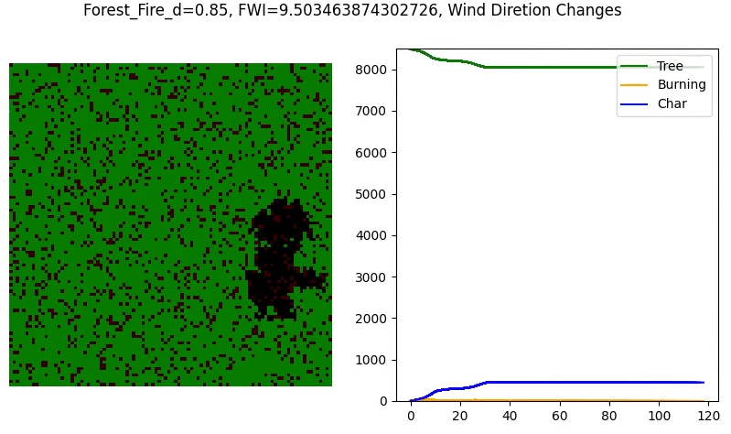

Slide 15
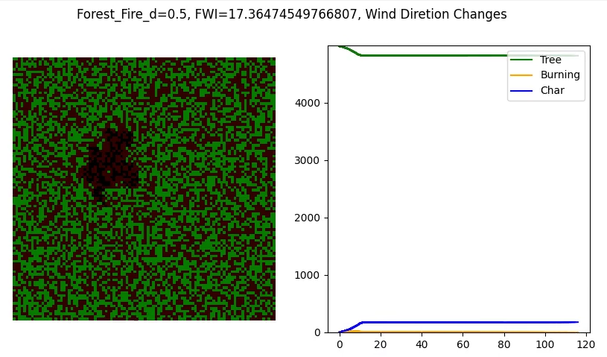
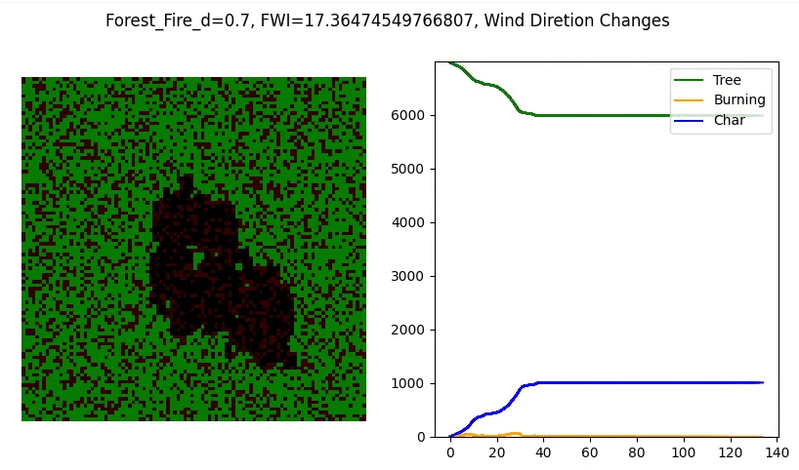
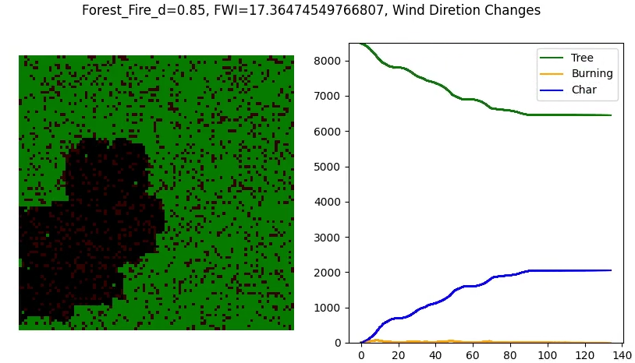

Slide 16
Conclusion
Density of tree has a reciprocal relationship with the occurrence of forest fire.
Wind can suppress the occurrence of forest fire.
Lower humidity greatly increases the probability of forest fire occur.
Higher temperature slightly increase the probability of forest fire occur.
It is more likely for forest fire to occur during the summer and winter season.

Slide 17
Thanks! Any questions or comments?

Slide 18
Reference List
https://cnr.ncsu.edu/news/2020/09/wildfires-expert-answers-to-your-burning-questions/#:~:text=There%20are%20three%20types%20of,growing%20just%20above%20the%20ground.
https://www.nfpa.org/News-and-Research/Publications-and-media/NFPA-Journal/2019/November-December-2019/Features/Large-Loss
https://ieeexplore.ieee.org/document/4939311
http://fire.org/downloads/farsite/WebHelp/technicalreferences/tech_modeling_fire_growth.htm
https://www.nwcg.gov/publications/pms437/cffdrs/fire-weather-index-system
https://www.sasquatchstation.com/Fire_Weather.php
https://github.com/buckinha/pyfwi/blob/master/pyFWI/FWIFunctions.py

